Slide 1
Conway’s Game of Life on FPGA

Slide 2
What is Conway’s Game of Life?
Notes:
It’s a cellular automaton invented by John Conway in 1970
Cellular automaton is a discrete model studied in several sciences
Consists of a regular grid of cells
Each cell has a finite number of states (like dead/alive)

Slide 3
Notes:
- Conway game of life uses the so called moore neighborhood

Slide 4
Underpopulation
Any live cell with fewer than two live neighbors dies

Slide 5
Overcrowding
Any live cell with more than three live neighbors dies

Slide 6
Survival
Any live cell with two or three live neighbors lives on

Slide 7
Birth
Any dead cell with three live neighbors will be born

Slide 8

Object examples:
Stable:
Oscillating:
Glider:
Special cases (f-Pentomino):
Notes:
Blinker: 2 cycles
Bipole: 2 cycles
Oktagon: 5 cycles
f-Pentomino: chaotic structure, more than 1000 generations chaotic -> results in oscillating state

Slide 9
Live Demo
Notes:
Pulsator: 15 cycles

Slide 10
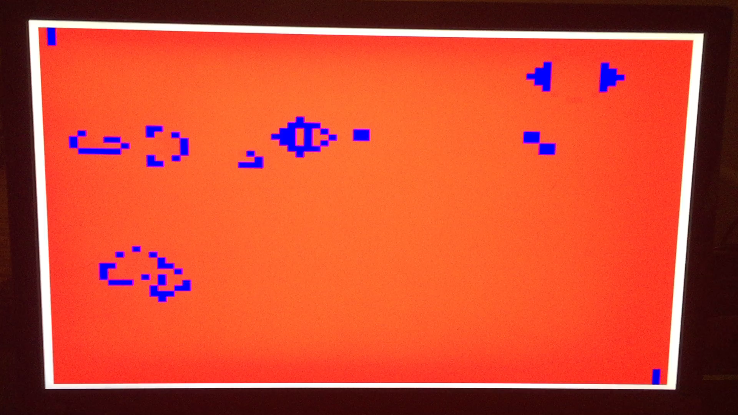

Slide 11
Process

Slide 12
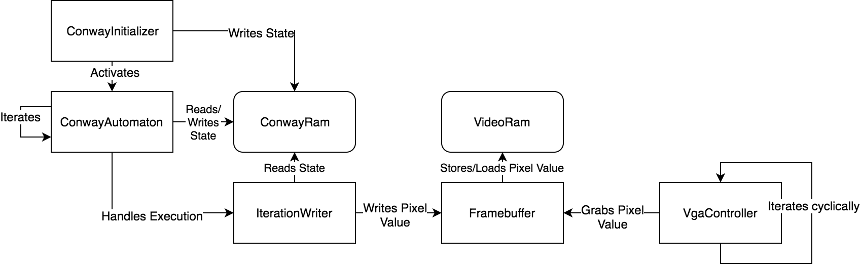

Slide 13
Implementation
Notes:
System runs at 106.6 Mhz
Output Resoulution is fixed to 1280*1024
For Readability and to safe memory I decided to calculate a lattice of 80 * 64 cells

Slide 14
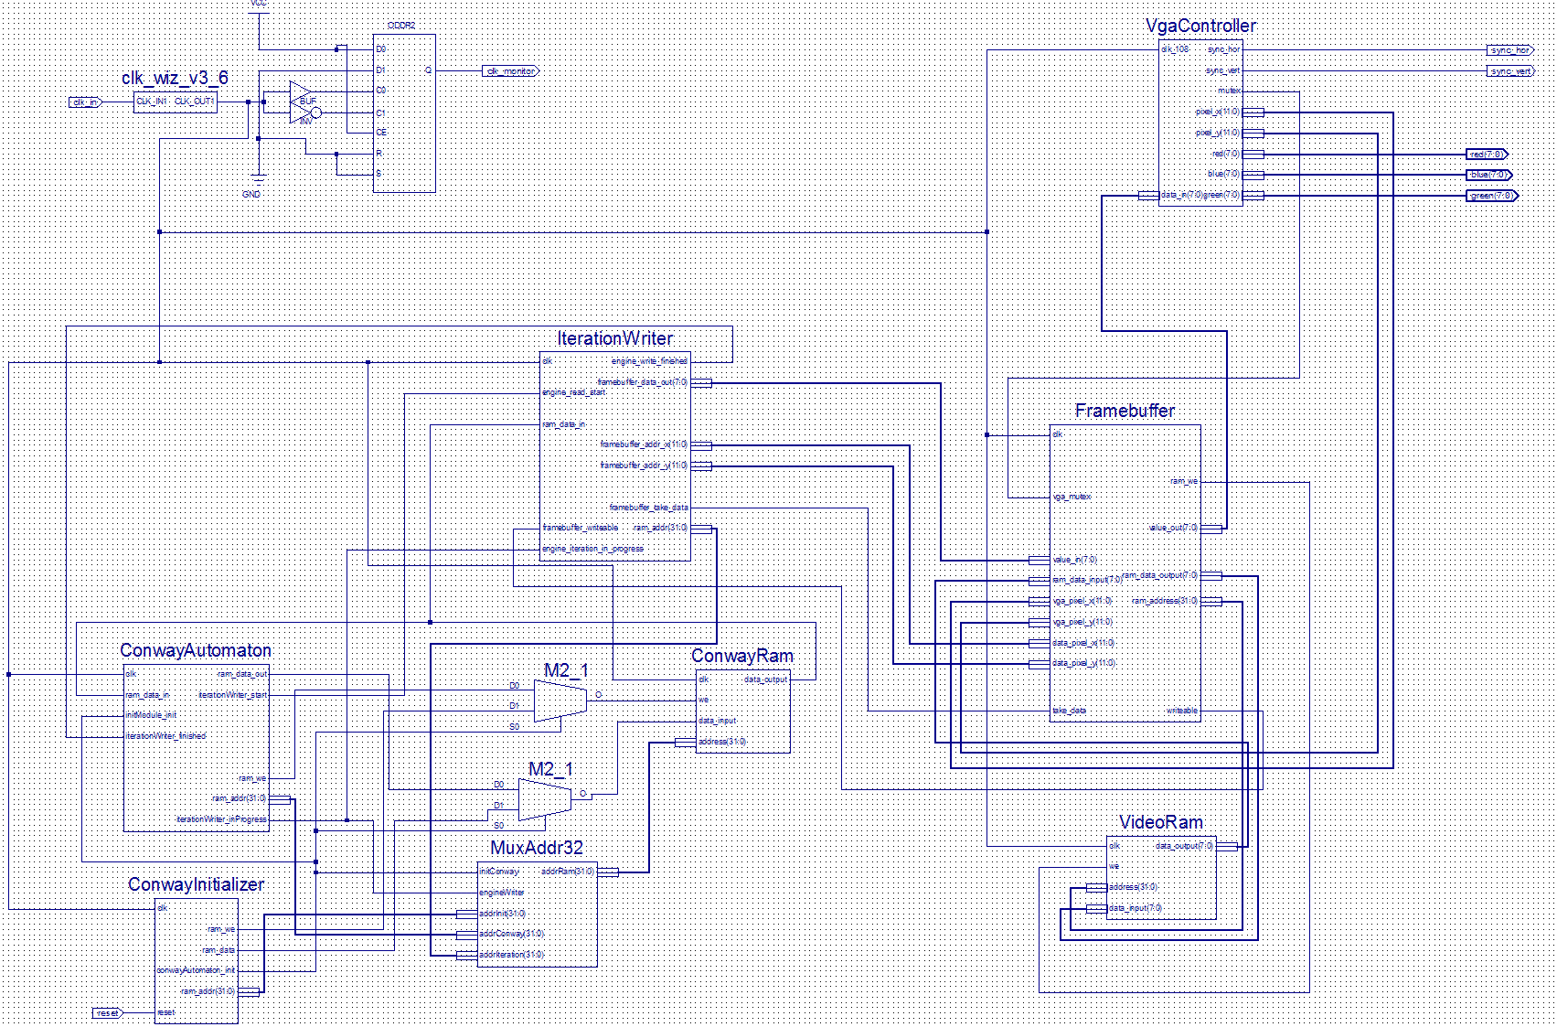

Slide 15
Design stupidity?
How the automaton could be even faster than it is right now?

Slide 16
Current
Possible
Notes:
Currently the process is build up like a loop over all cells:
- Easy to develop and fits requirements
<-> not the fastest possible solution: Divide Grid in subgrids and run the loop on them
Needed changes: arbiter needed that controls the ram access and so.

Slide 17
Combinational Circuit
Memory
Notes:
Calculate the state in an combinational circuit and write result for each cell back to memory

Slide 18
Possible Extensions

Slide 19
Reset Function
Easy Initializer
Direct Deploy
Iteration Counter

Slide 20
Thank you!
Feel free to checkout the project on GitHub:
https://github.com/johannes5117/ConwayVHDL-Spartan6

Slide 21
Images:
Images on slide 8 are from Wikipedia:
https://de.wikipedia.org/wiki/Conways_Spiel_des_Lebens
The other images were self-painted

